Slide 1

6.3 Modifying default.css
To change the stylesheet settings, the first procedure is to download the existing default.css.
Next, change the existing styles of the default stylesheet to your desired settings.
Last, to upload the new default.css file to the NBCH web.
Step 1. Click on the icon, to enter the File Management page.

Slide 2
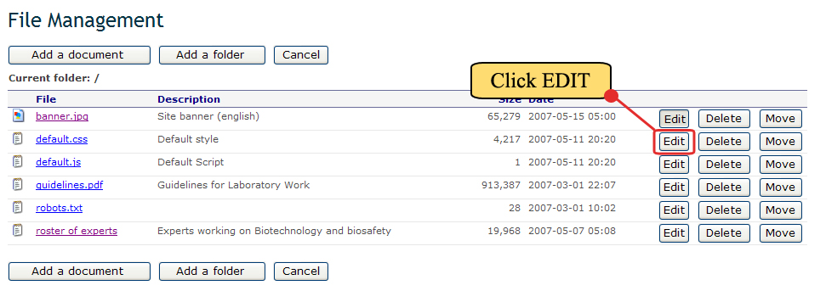
6.3 Modifying default.css
Step 2. Inside the File Management, click the Edit button to the right of the File named default.css.

Slide 3
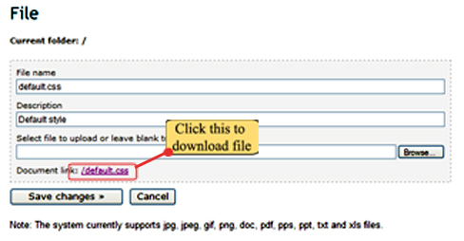
6.3 Modifying default.css
Step 3. Inside the File page, under Document link: click on /default.css to download the stylesheet.

Slide 4
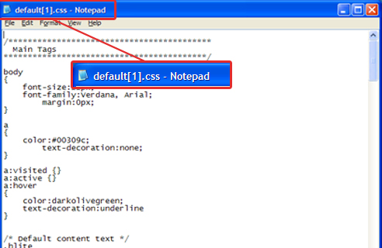
6.3 Modifying default.css
The default stylesheet file will automatically download to the computer and will be opened using Notepad.
Observe that the filename is changed to default[1].css.

Slide 5
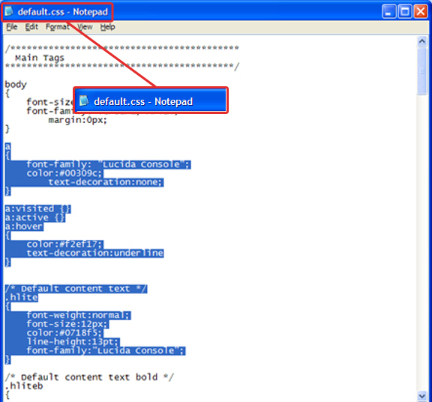
6.3 Modifying default.css
Step 4. Using this downloaded file, modify the stylesheet properties to your desired settings. For this example, we follow the settings discussed from the previous section. After editing, save the new stylesheet using default.css as its filename.
Edited section in blue highlight.
File saved as default.css.

Slide 6
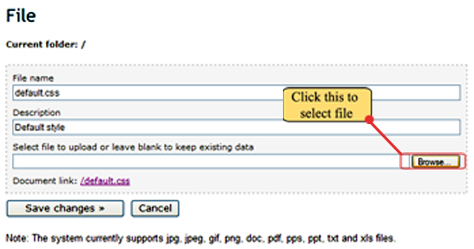
6.3 Modifying default.css
Step 5. Next step is uploading the new default.css. Return to the File page. Click on the browse button to select default.css from the computer.

Slide 7
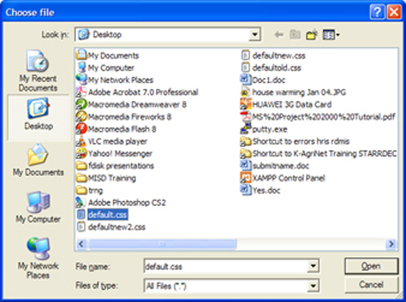
6.3 Modifying default.css
Step 6. The Choose file window will appear. Now, browse your computer to locate for the updated default.css. Then click on Open button to select.
NEW DEFAULT.CSS
CLICK HERE

Slide 8
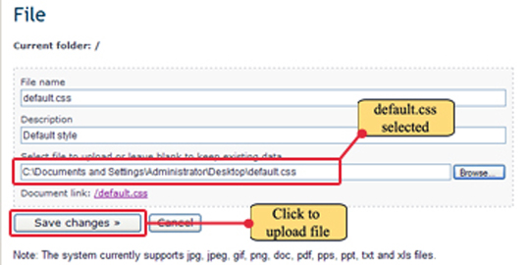
6.3 Modifying default.css
Step 7. After selecting, the File page reappears with default.css been selected. Now, click Save changes button to upload the file. This action will upload the new default.css. The new settings will now be implemented to the site.

Slide 9
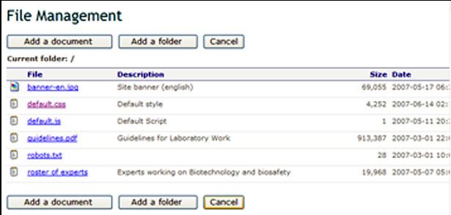
6.3 Modifying default.css
Step 8. The File Management reappears. Now, click cancel to return to the main page.
CLICK HERE

Slide 10
6.3 Modifying default.css
Step 8. Now, the main page reappears. Initially, it will be observed that the new settings are not yet implemented by the page. Press F5 to refresh the page. Refreshing will implement the settings included in the uploaded default stylesheet.

Slide 11
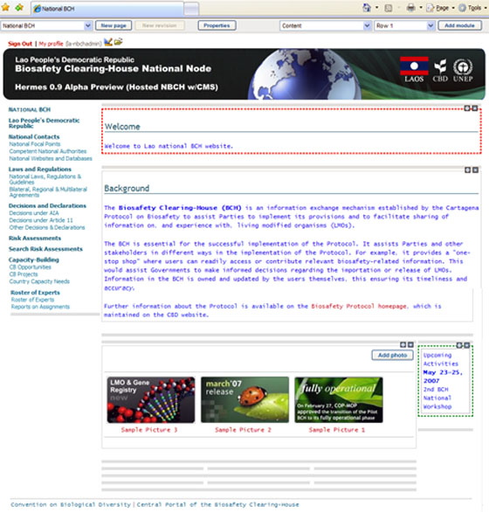
6.3 Modifying default.css

